Slide 1
Take your hand
-- request matching application
By Anson, hinS

Slide 2
Introduction
Purpose
Function
Process
Benefits
Video

Slide 3



Purpose
provide after school care for dual-career family
  to prevent children being left unattended at home
to connect the neighborhood
  by helping them to take care children

Slide 4

Function
Post request
  Ask for any available services or family
Search the detail of after-school care provided by organization and individuals
Matching request and available services
Communicating function

Slide 5
Process
Request
With requirement
Matching
Any available services
Accept
Pay by online banking

Slide 6

Benefits
Help full time mother to get extra income
Relationship in the neighborhood become closer
Parents can reduce the fee of playgroup

Slide 7
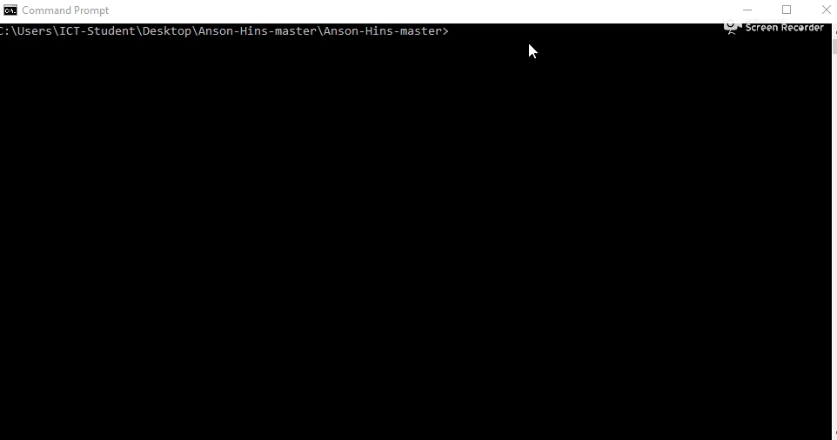
Demo video

Slide 8
End

